Slide 2
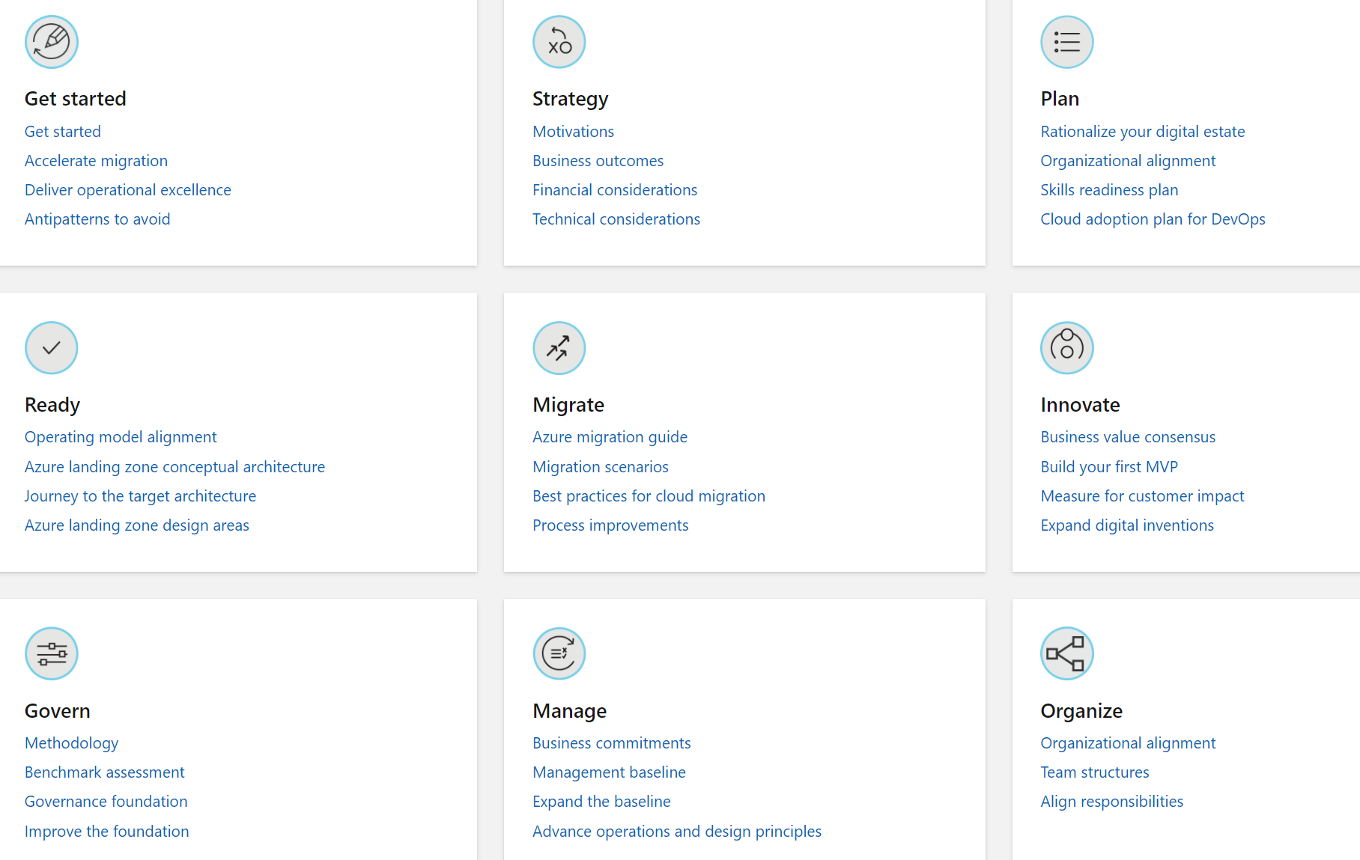
Cloud Adoption Framework
Notes:
https://docs.microsoft.com/en-us/azure/cloud-adoption-framework/

Slide 3
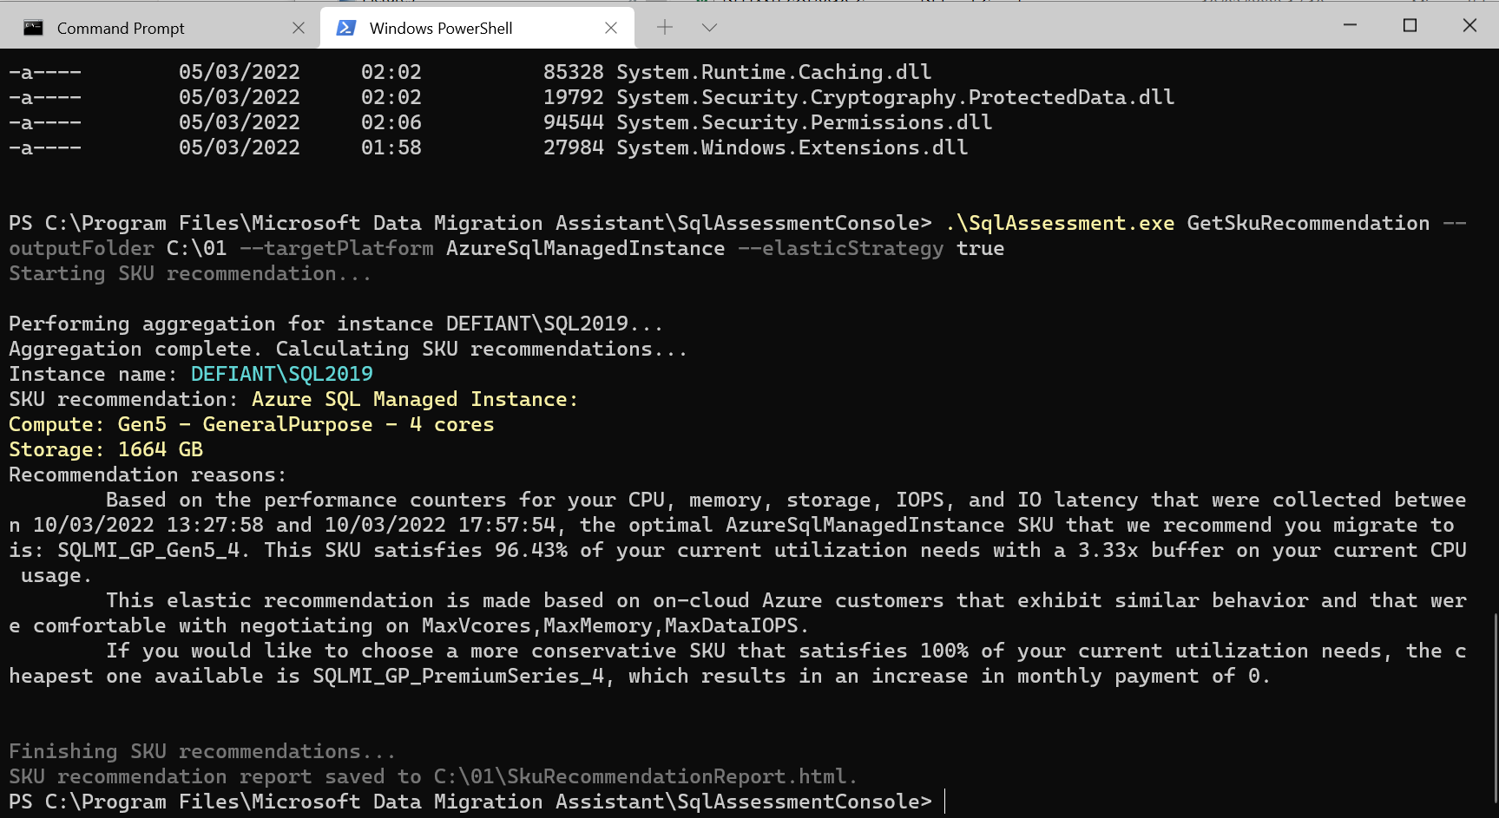
SQL Assessment
.\SqlAssessment.exe GetSkuRecommendation --outputFolder C:\01 --targetPlatform AzureSqlManagedInstance --elasticStrategy true
Notes:
https://docs.microsoft.com/en-ie/sql/dma/dma-sku-recommend-sql-db?view=sql-server-ver15

